Slide 1
Parrot Drone Simulation
For Petronas competition

Slide 2
Requirement
Ubuntu 1804
OpenGL version 3.0 or higher
**Check OpenGL:
$ glxinfo | grep "OpenGL version"

Slide 3
Installation
Olympe- https://developer.parrot.com/docs/olympe/installation.html
** For the section “Install olympe-linux dependencies”, choose EITHER “Recommended dependency installation procedure” OR “Manual dependency installation”
Sphinx- https://developer.parrot.com/docs/sphinx/installation.html

Slide 4
Example code from Petronas
Create a folder named <petronas> at home repository
$ cd
$ mkdir –p petronas
$ cd ~/petronas
Clone github repository given by Petronas into the folder
$ git clone https://github.com/Petronas-Robotics/Parrot_GSDK-training.git

Slide 5
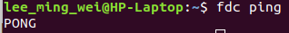
Sphinx
Activate Sphinx firmware
$ sudo systemctl start firmwared.service
Check firmware
$ fdc ping
**You should get a PONG in response.

Slide 6
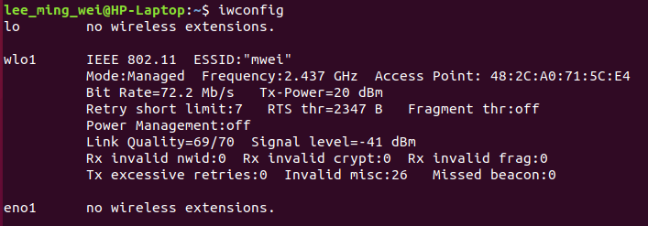
Sphinx
Check wifi interface
$ iwconfig
This is the <interface name>

Slide 7
Sphinx
The simulation launch format:
$ sphinx /opt/parrot-sphinx/usr/share/sphinx/drones/anafi4k.drone::stolen_interface=<interface name>:eth0:192.168.42.1/24
**In my case, interface name = wlo0
Therefore,
$ sphinx /opt/parrot-sphinx/usr/share/sphinx/drones/anafi4k.drone::stolen_interface=wlo0:eth0:192.168.42.1/24

Slide 8
Sphinx
Note: In my case, the wifi interface name will change when the simulation is launched for 2nd time. So the wifi interface name should be checked every time before launching.

Slide 9
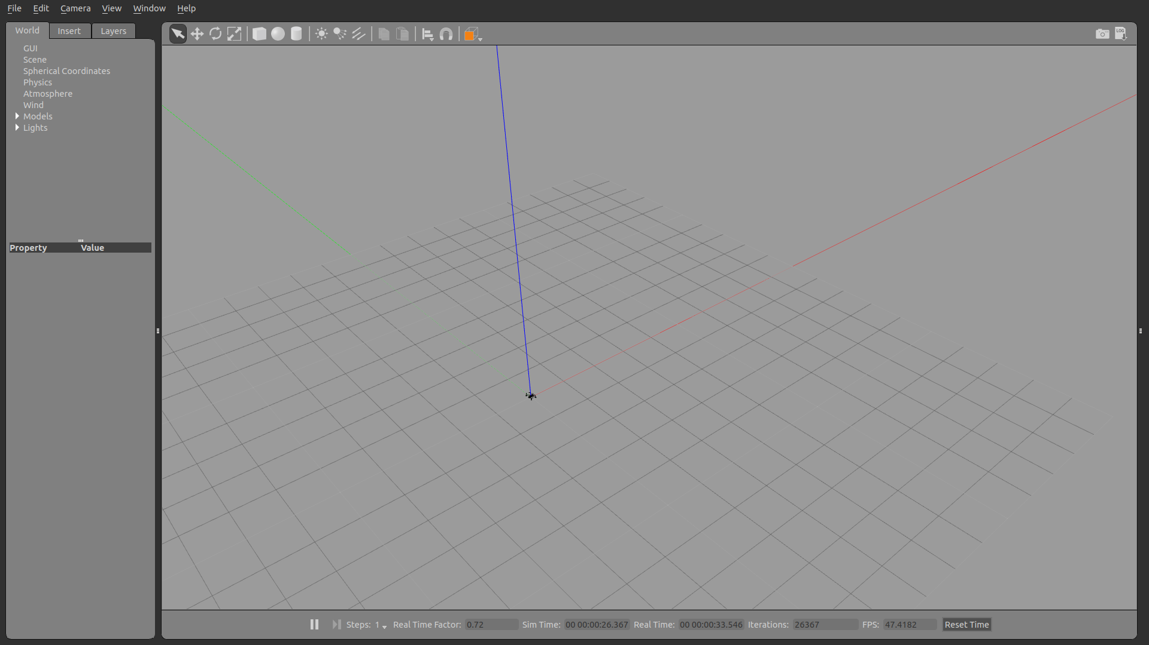
Sphinx
Gazebo will run and a simulated drone (Anafi) will be launched.

Slide 10
Sphinx
When stolen_interface is TRUE,
-the wifi will be blocked by Sphinx and the user can't access to internet (such as Google Chrome).
-the simulated drone will create a wifi named "Anafi_PC_6f2a48", this allow user to connect to the simulated drone with physical controller/software like FreeFlight.

Slide 11

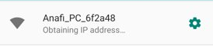
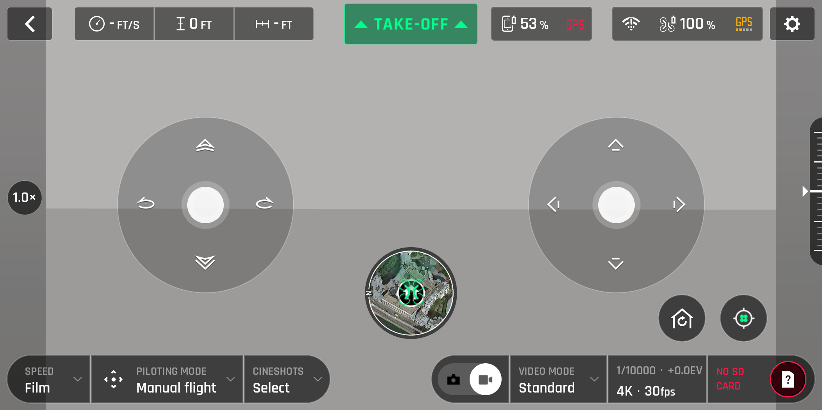
Sphinx-Control the simulated drone with FreeFlight 6 (drone piloting software)
Download FreeFlight 6 in smartphone or tablet
Connect to Anafi wifi
Open the software and ready to fly

Slide 12
Sphinx
In other case, you can leave stolen_interface as FALSE
$ sphinx /opt/parrot-sphinx/usr/share/sphinx/drones/anafi4k.drone::stolen_interface=
-but the simulated drone won't create a wifi, so no connection between controller and the simulated drone is allowed
**Issue-the drone can't perform landing properly- bug?

Slide 13
Sphinx + olympe
In order to control the drone in sphinx simulation by using olympe, terminal 1 is used to launch the simulation and terminal 2 is used to control the drone by using olympe python code.

Slide 14
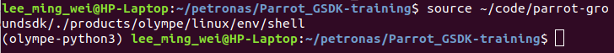
Olympe
Setup Olympe environment
$ cd ~/petronas/Parrot_GSDK-training
$ source ~/code/parrot-groundsdk/./products/olympe/linux/env/shell
**the shell prompt should be prefixed by (olympe-python3)

Slide 15
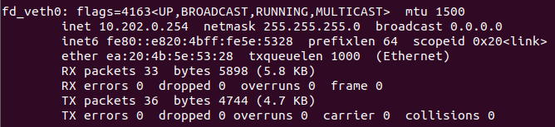
Connection issue
Check the IP address of the simulated drone
$ ifconfig
Check this IP
Check this value, 1/0

Slide 16
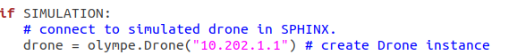
Connection issue
The default IP of the simulated drone is “10.202.0.1”, so if you get 1 in the IP obtained in previous slide, you need to edit the python file to change the drone IP to 1.
Change this from 0 to 1 (for such case)

Slide 17
Connection issue
Note: In my case, the IP will change time by time, so the IP should be checked time by time.

Slide 18
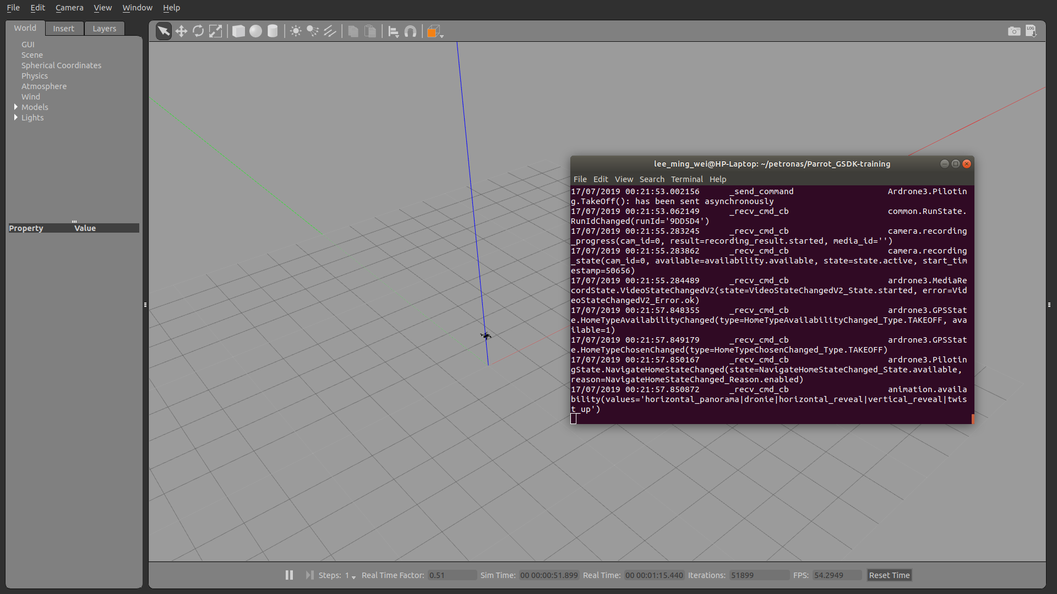
Control the drone using python code
(olympe-python3) $ python3 1_takeoff_land.py
The drone will take off and land.

Slide 19
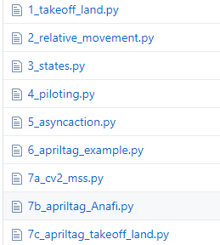
Control the drone using python code
Can try with other python code.
Remember to change IP (if needed).
Issue: The movement of the drone does not exactly follow the value (pi/1m)

Slide 20
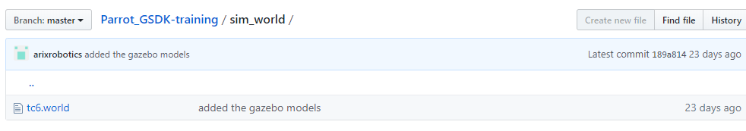
Load obstacle world
The format to load a world and a drone in the simulation:
$ sphinx <path/to/my.world> <path/to/my.drone>
The obstacle world provided by Petronas can be found in the Parrot_GSDK-training folder.

Slide 21
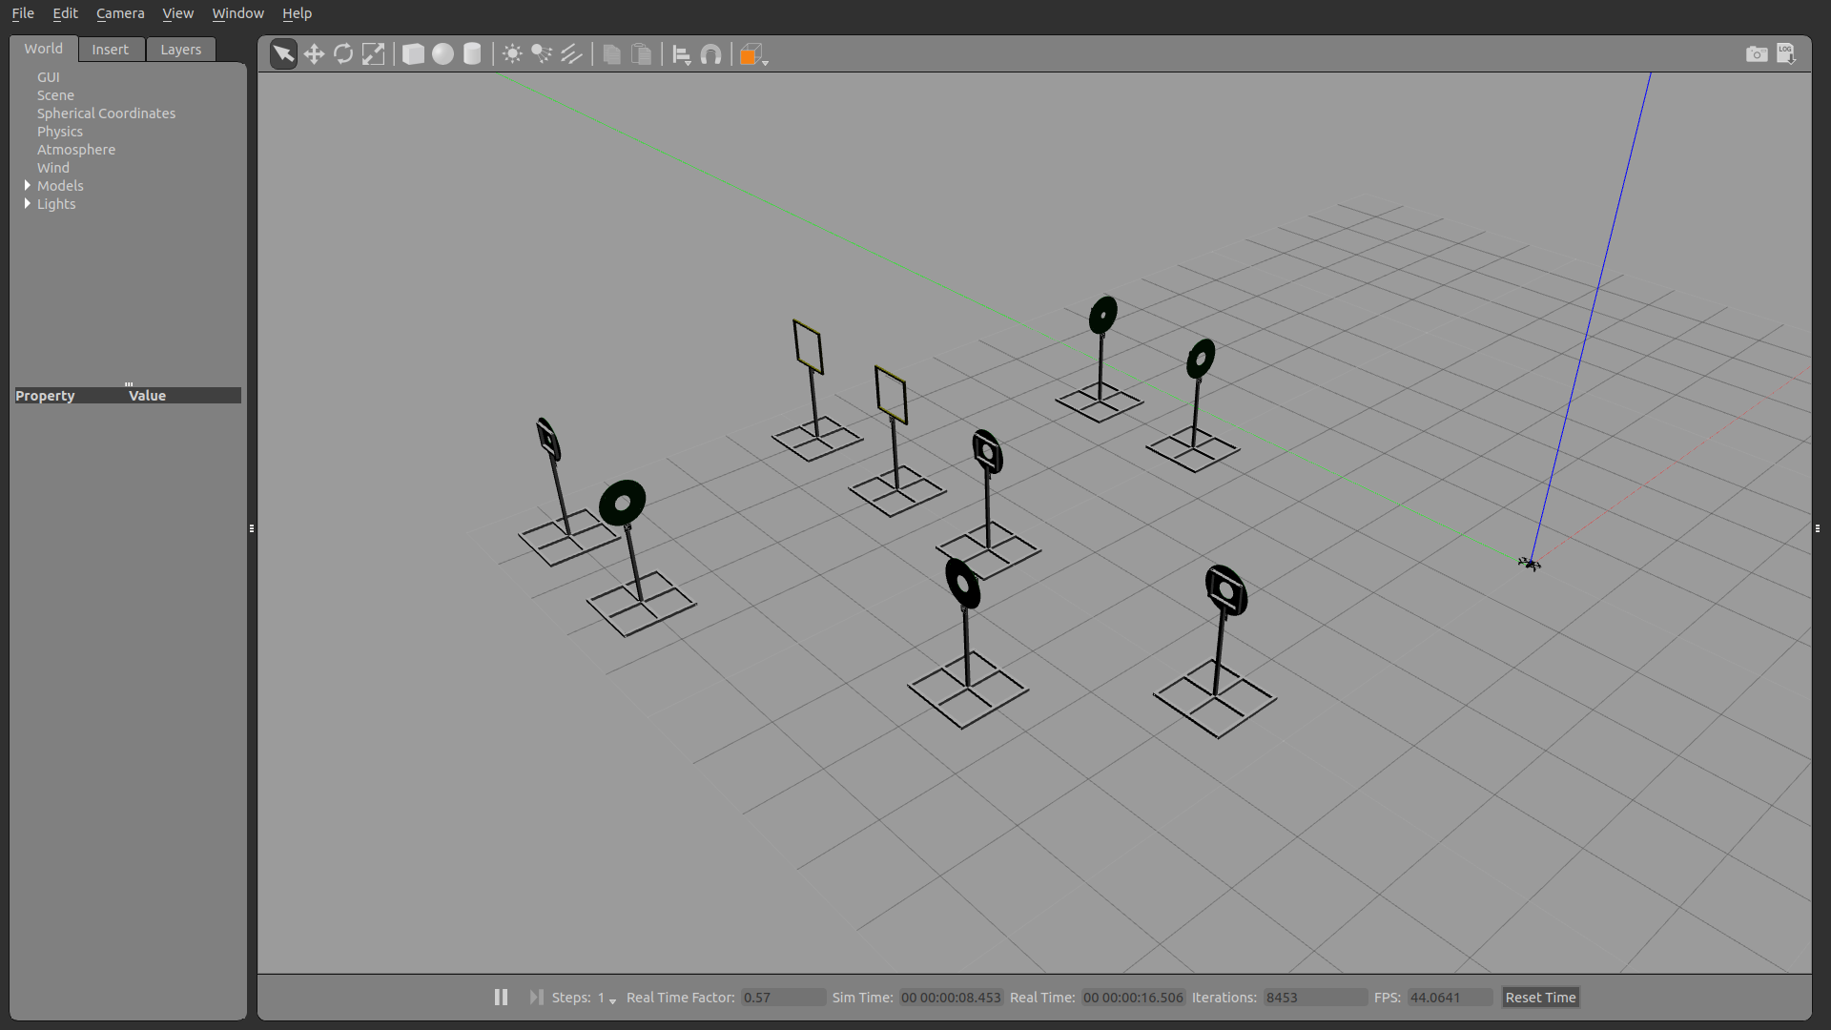
Load obstacle world
$ sphinx ~/petronas/Parrot_GSDK-training/sim_world/tc6.world /opt/parrot-sphinx/usr/share/sphinx/drones/anafi4k.drone::stolen_interface=<interface name>:eth0:192.168.42.1/24
Result:

Slide 22
Tag scanning
Install Apriltag
$ pip3 install apriltag
Install OpenCV
https://www.pyimagesearch.com/2018/05/28/ubuntu-18-04-how-to-install-opencv/

Slide 23
Install OpenCV dependencies
$ sudo apt-get update
$ sudo apt-get upgrade
$ sudo apt-get install build-essential cmake unzip pkg-config
$ sudo apt-get install libjpeg-dev libpng-dev libtiff-dev
$ sudo apt-get install libavcodec-dev libavformat-dev libswscale-dev libv4l-dev
$ sudo apt-get install libxvidcore-dev libx264-dev
$ sudo apt-get install libgtk-3-dev
$ sudo apt-get install libatlas-base-dev gfortran
$ sudo apt-get install python3-dev

Slide 24
Download OpenCV source
$ cd ~
$ wget -O opencv.zip https://github.com/opencv/opencv/archive/3.4.4.zip
$ wget -O opencv_contrib.zip https://github.com/opencv/opencv_contrib/archive/3.4.4.zip
$ unzip opencv.zip
$ unzip opencv_contrib.zip
$ mv opencv-3.4.4 opencv
$ mv opencv_contrib-3.4.4 opencv_contrib

Slide 25
Install pip and python package
$ wget https://bootstrap.pypa.io/get-pip.py
$ sudo python3 get-pip.py
$ pip3 install numpy

Slide 26
Build OpenCV
$ cd ~/opencv
$ mkdir build
$ cd build

Slide 27
Compile OpenCV
$ cmake -D CMAKE_BUILD_TYPE=RELEASE \
-D CMAKE_INSTALL_PREFIX=/usr/local \
-D INSTALL_PYTHON_EXAMPLES=ON \
-D INSTALL_C_EXAMPLES=OFF \
-D OPENCV_ENABLE_NONFREE=ON \
-D OPENCV_EXTRA_MODULES_PATH=~/opencv_contrib/modules \
-D BUILD_EXAMPLES=ON ..
$ make -j4

Slide 28
Install OpenCV
$ sudo make install
$ sudo ldconfig

Slide 29
Python + OpenCV
$ cd /usr/local/python/cv2/python-3.6
$ sudo mv cv2.cpython-36m-x86_64-linux-gnu.so cv2.so

Slide 30
Checking the installation
$ python3
$ import apriltag
$ import cv2
*install successfully if get no error
$ quit()

Slide 31
Run apriltag example-with laptop webcam
$ cd ~/petronas/Parrot_GSDK-training
$ python3 6_apriltag_example.py
-use your phone to search google image for "apriltag image", then show the image to the webcam for detection.

Slide 32
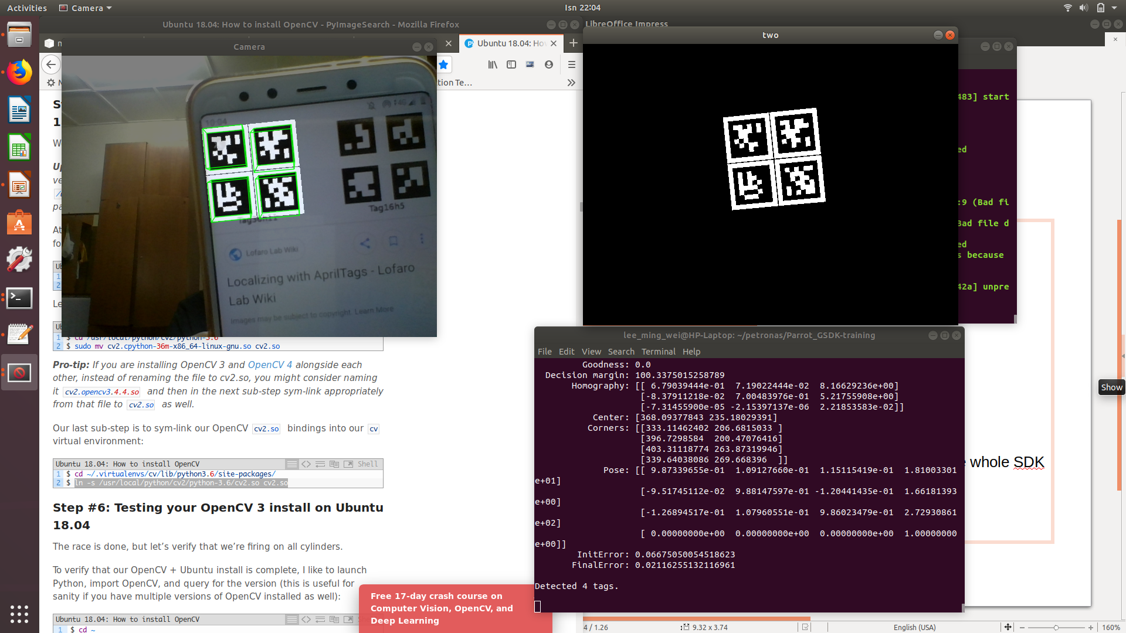
Run apriltag example-with laptop webcam
Result:

Slide 33
mss
Install mss
$ pip3 install mss
Run the mss example
$ python3 7a_cv2_mss.py
-screenshot of the monitor should be shown

Slide 34
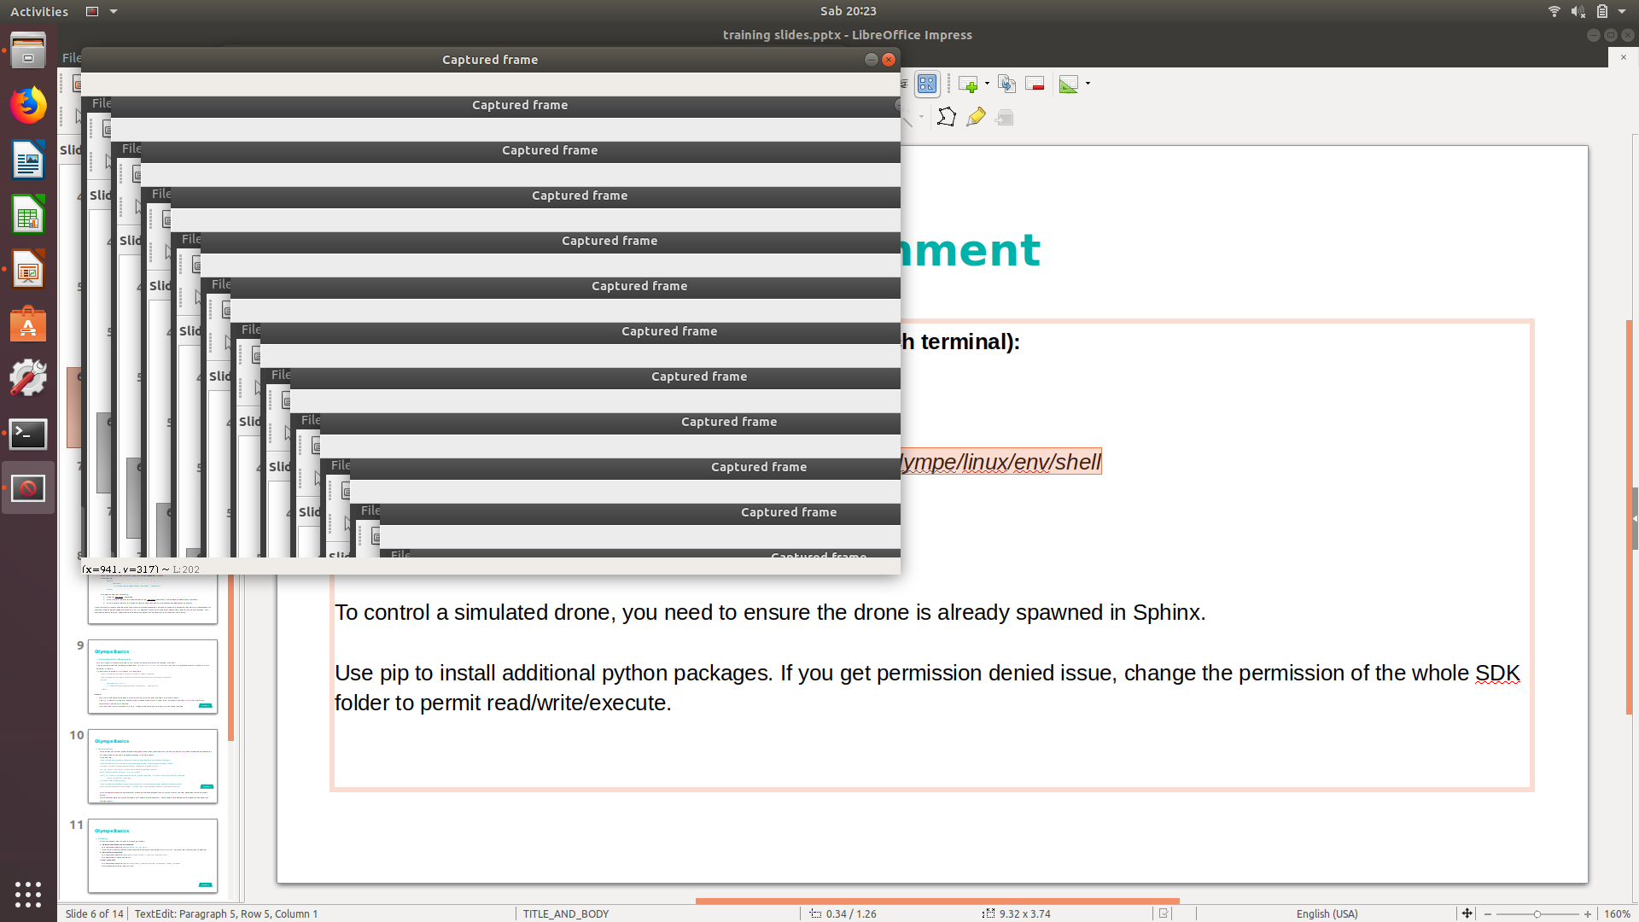
mss
Issue: new screenshot keep showing- bug?

Slide 35
Apriltag with drone
Run the sphinx simulation then,
$ python3 7b_apriltag_Anafi.py
$ python3 7c_apriltag_takeoff_land.py

Slide 36
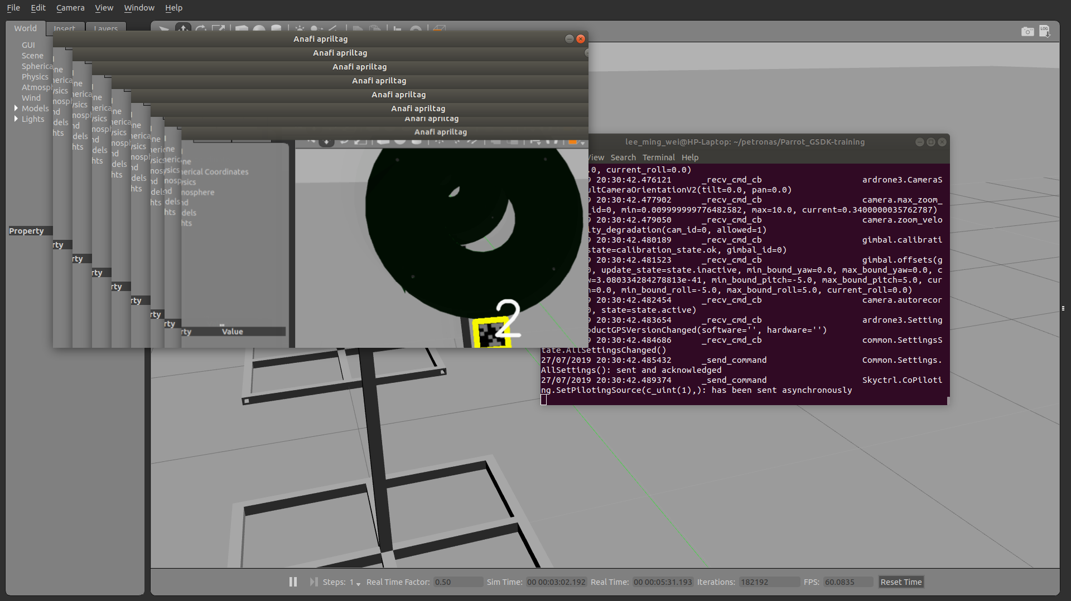
Apriltag with drone
When apriltag shows in the screen, the program will detect it.
The drone will stream video to the computer and the video will be shown in the screen. When apriltag appears in the FOV of the camera, detection will be done.

Slide 37
Updated Issue
Sometime Olympe environment cannot be setup after restart
$ source ~/code/parrot-groundsdk/./products/olympe/linux/env/shell
An error will show after running this command
Solve by rebuild olympe-linux
$ cd ~/code/parrot-groundsdk
$ ./build.sh -p olympe-linux -A all final -j

Slide 38
Video streaming from drone
Go to https://raw.githubusercontent.com/Parrot-Developers/olympe/master/src/olympe/doc/examples/streaming.py , copy the code and save as python file (video_streaming_detection.py) in ~/petronas folder.

Slide 39
Video streaming from drone
Launch drone simulation in terminal 1
$ sphinx /opt/parrot-sphinx/usr/share/sphinx/drones/anafi4k.drone::stolen_interface=
Launch video streaming python code in terminal 2
$ cd ~/petronas
$ source ~/code/parrot-groundsdk/./products/olympe/linux/env/shell
$ python video_streaming_detection.py

Slide 40
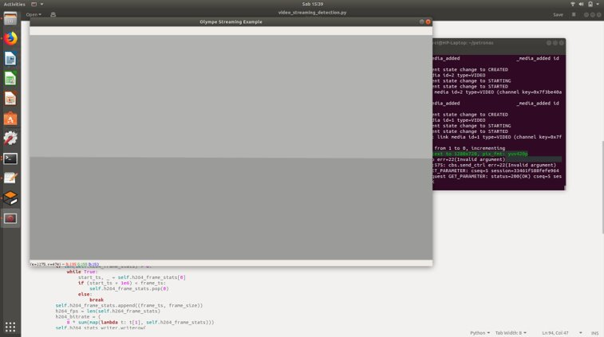
Video streaming from drone
A streaming window will be shown

Slide 41
OpenCV detection
Go to https://github.com/edytiew/SKTiew/blob/master/streaming.py, download the code.
Run in simulation or connect to physical drone.

